Slide 1
AEROBIC EXERCISES FOR MALES OVER 65

Slide 2
Learning objectives
Identify types of activities that are beneficial to this age group and increasing their health.
Describe how these activities or aerobic exercises can improve health and benefit the patient.
List ways for healthcare providers to increase attendance of such exercises and increase awareness among patients.
Describe positive aspects of aerobic exercises versus decreased exercise with aging and how health promotion activities can increase lifespan and quality of life in the elder person, especially with comorbidities.

Slide 3
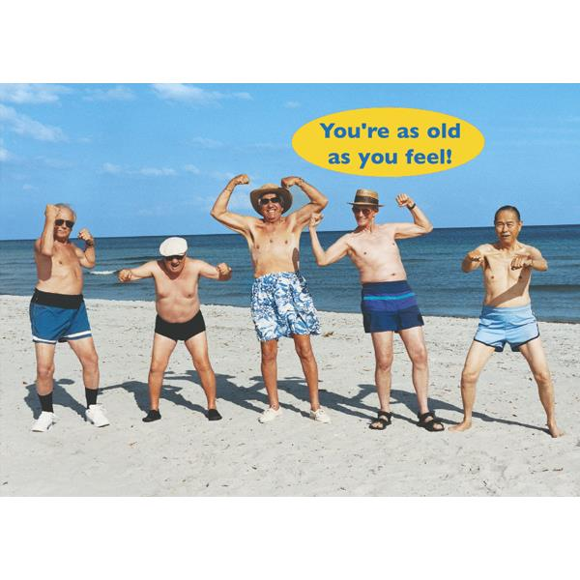
WHAT IS EXACTLY AEROBIC EXERCISING?

Slide 4
Aerobic exercise provides cardiovascular conditioning. The term aerobic actually means “with oxygen”, which means that breathing controls the amount of oxygen that can make it to the muscles to help them fuel and move.

Slide 5
Why is aerobic exercise important for you
It is the most important thing you can do for your health!
Strengthens your cardiovascular system
Improves muscle strength
Improves lung function
Helps to control/better blood sugar

Slide 6
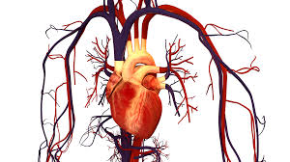
How does exercising help your cardiovascular system
LOWERS BLOOD PRESSURE
PREVENTS PLAQUE BUILD UP INSIDE THE WALLS OF ARTERIES
PROTECTS YOUR ARTERIES TO HELP BLOOD FLOW
MAKES CLOTS LESS LIKELY TO FORM
HELPS FORM NEW ARTERIES FOR BLOOD TO GO TO IF OTHER ARTERIES GET BLOCKED

Slide 7
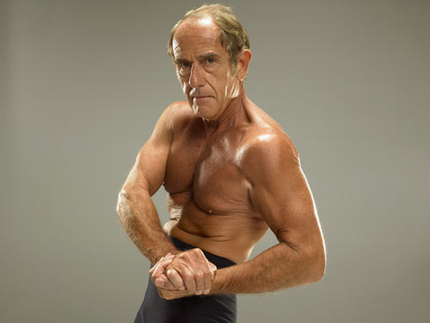
MAKE YOUR MUSCLES STRONGER!
Exercise is critical for strong muscles and bones. Muscle strength declines as people age, but studies report that when people exercise, they are stronger and leaner than others in their age group. They are also better able to perform daily chores, and remain independent longer than their inactive peers. Many older men who exercise report less pain/disability!

Slide 8
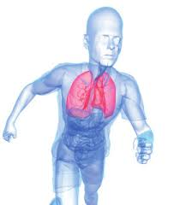
AEROBIC EXERCISES AND LUNG FUNCTION
The average person’s lung capacity can be improved by 5 percent to 15 percent even with frequent intense aerobic workouts. Everyone is born with a specific maximum lung capacity, called VO2 Max, which refers to the rate of oxygen flow. When your heart rate increases during aerobic exercise, your oxygen consumption increases: this provides the necessary energy to your muscles for the strenuous activity.

Slide 9
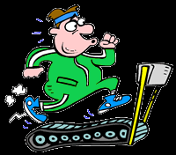
Control your blood sugar
Insulin sensitivity is increased when you exercise, so your cells are better able to use any available insulin to take up glucose during and after activity.
When your muscles contract during activity, it stimulates another mechanism that is completely separate of insulin. This mechanism allows your cells to take up glucose and use it for energy whether insulin is available or not.

Slide 10
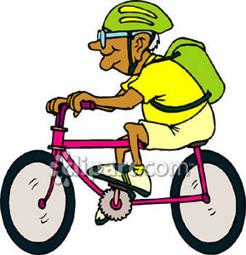
Examples of aerobic exercises
SWIMMING
CYCLING
WALKING
ROWING
JUMPING ROPE
STEP AEROBICS

Slide 11
How are these exercises beneficial
Swimming to increase blood flow and circulation
Brisk walking or jogging daily to increase perfusion
Biking can improve edema and circulation as well as blood flow
Dancing is a fun activity many older adults enjoy that can also improve circulation and cognitive function

Slide 12
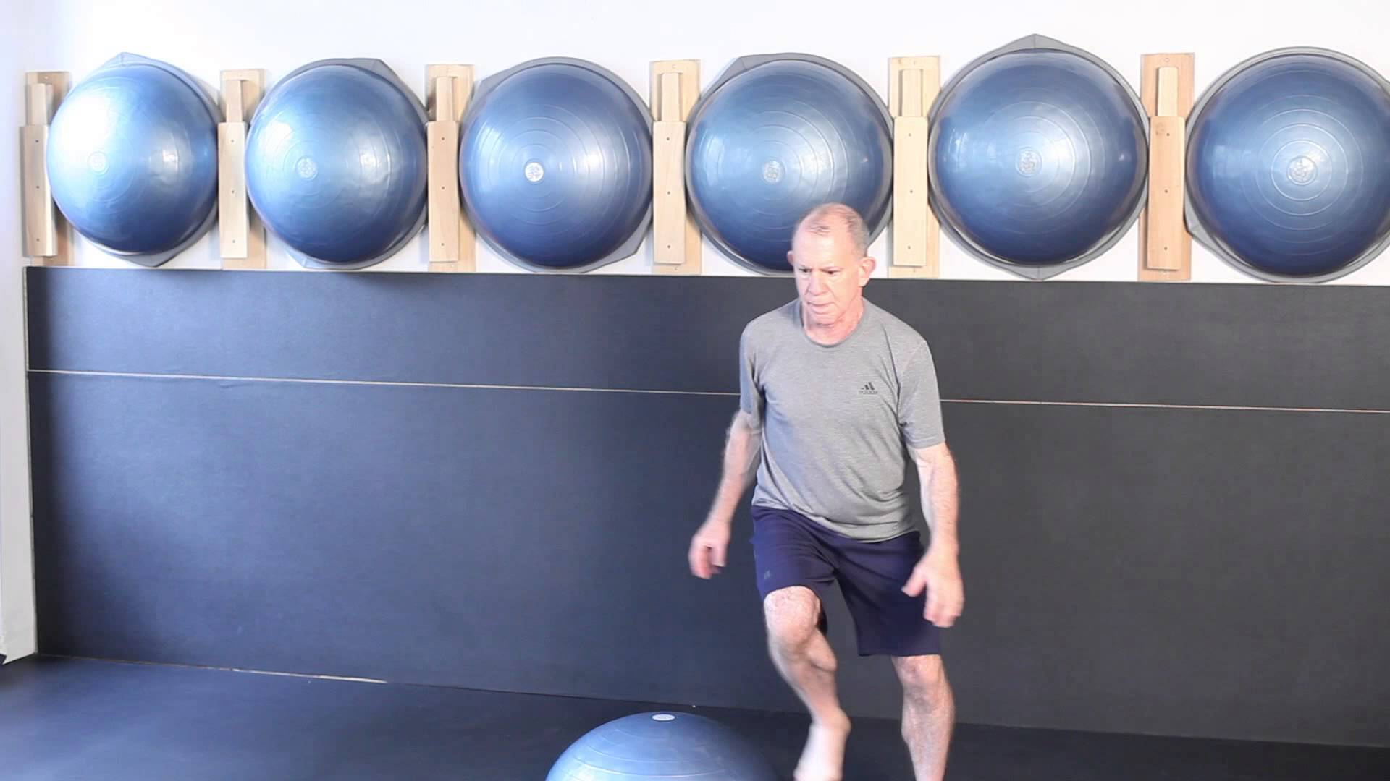
15 minute senior work out for at home! (example)
https://www.youtube.com/watch?v=K727ao6Kjr4

Slide 13
PROGRESSION OF AEROBIC EXERCISE
Progression to higher intensities of exercise should be based on individual exercise tolerance.
There are three methods for challenging aerobic fitness:
increase the speed
increase the resistance
increase the duration
Any of these methods, or a combination of these methods, will improve aerobic fitness. Increasing intensity should be done very gradually. You should challenge yourself for only a few minutes at a time.

Slide 14
HOW LONG SHOULD THE EXERCISE LAST
The American Heart Association recommends that everyone reach a minimum of 30 minutes of some form of cardiovascular exercise 5 to 7 days per week.
Can be broken up into 10-minute time periods.
It is appropriate to do aerobic exercise every day. There is no need to rest in between sessions unless you are at an extreme level of training, such as preparing for a marathon, or if you experience reoccurring joint pain.

Slide 15
The difference between moderate and vigorous exercising
What does moderate aerobic exercise feel like?
  You are at a moderate intensity when your breathing and heart rate are noticeably increased. You can still carry on a full conversation, but you will be breathing heavier and may be sweating. On a 10-point scale, with zero being a state of rest, moderate would be a 5 or 6.
What does vigorous exercise feel like?
  At a vigorous intensity you are breathing rapidly and no longer able to easily carry on a full conversation, just short phrases. Your heart rate is boosted and you will probably break a sweat. On a scale from 1 to 10, vigorous exercise would be a 7 or 8.

Slide 16
For even more benefit…
ADD STRENGTH TRAINING 2 TO 3 TIMES PER WEEK
Strength training exercise is especially important for older adults to prevent loss of muscle mass and bone density, as well as to be able to move and function better.
How Many: Do 8 to 10 strength-training exercises, 8 to 12 repetitions of each.
How Often: 2 to 3 days each week
What Are Strength Training Exercises?
Lifting, pushing and pulling exercises will build muscle strength and endurance. You can use exercise machines at the gym, resistance bands, or free weights such as dumbbells, barbells, medicine balls and kettlebells.

Slide 17
A ROLE AS A HEALTHCARE TEAM MEMBER
The healthcare team member should assess the older adults engagement in physical activity and determine what they mean by physical activity in terms of intensity, duration, and type of exercise. The patient should also be provided with information and referral to a dietician if needed for additional information on staying healthy as they age. The healthcare provider needs to do a physical assessment and tell the patient what limitations the patient has regarding types of exercise and explain the best exercise guided to the specific patient.

Slide 18
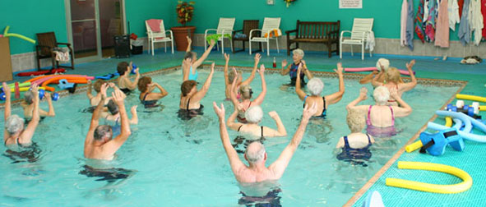
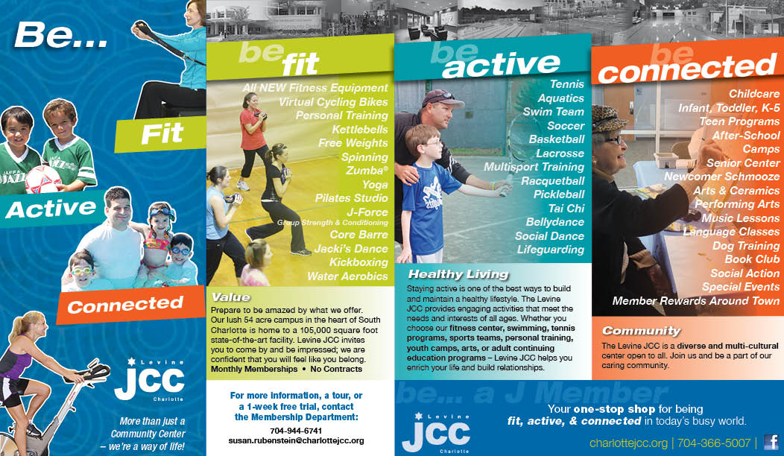
HOW TO INFLUENCE AEROBIC EXERCISING
Create or show awareness of any indoor/outdoor aerobic training sessions
Give out brochures to your patients 65 and older as a “teaching tool” to show how aerobic exercising benefits them

Slide 19
you need more exercise than just your daily activities as you get older
Some people might think that mere daily routine activities is enough exercise which a health body needs to maintain good health however, this is untrue! Studies have conclusively proven that persons who do not have enough and sound daily physical exercises are more prone to cardiac and chronic diseases, and that maintaining a good fitness (according to right standards) protects people against common diseases; especially cardiac diseases, high blood pressure, and arthralgia.

Slide 20
REFERENCES
Center for Disease Control and Prevention. (2005, February). Physical Activity and Health: Older Adults . In CDC. Retrieved February 13, 2016, from http://www.cdc.gov/nccdphp/sgr/olderad.htm
Meade M.D., R. J. (2001, February 1). Promoting and Prescribing Exercise for the Elderly. In American Family Physician. Retrieved February 12, 2016, from http://www.aafp.org/afp/2002/0201/p419.html
Office of Disease prevention and Promotion. (2016). Active Older Adults. In Health.gov. Retrieved February 12, 2016, from http://health.gov/paguidelines/guidelines/chapter5.aspx

